Slide 1
FMCG Network Infrastructure Design
Team Members
Arijit Chakma
Md Alamgir Hossain
Md Moksudul Haque

Slide 2
Part 01: Cisco On-Premises Solution1. Background
This section presents the Cisco on-premises network design for the FMCG client. The client requires a secure, scalable and durable network for nine departments: Marketing, Sales, HR, Technical, Customer Service, Financial, Strategy, Legal and Quality Control. Because the client also asked for possible expansion, the design must support both current users and future growth while maintaining a 10 Gbps-capable backbone.
The Cisco solution uses a private Class B address space, Variable Length Subnet Masking (VLSM), departmental VLAN segmentation and a hierarchical star topology. These choices improve IP address efficiency, simplify network management and support higher security by separating department traffic.
2. Department Host and Printer Requirements
The first step is to calculate how many IP addresses are needed for each department. Growth buffers were added exactly as needed in the project requirement: 10% for Sales and Quality Control, and 20% for Customer Service.
Printer allocation follows the rule of 1 printer for every 30 employees, with at least one printer for smaller departments which have fewer than 30 employees.
Department | Current Staff | Growth | Total Hosts Needed (staffs) | Printer Calculation** | Printers
Marketing | 40 | None | 40 | 40/30 = 1.33 > 2 | 2
Sales | 200 | 10% | 200 + 20 = 220 | 220/30 = 7.33 > 8 | 8
HR | 50 | None | 50 | 50/30 = 1.67 > 2 | 2
Technical | 30 | None | 30 | 30/30 = 1.00 > 1 | 1
Customer Service | 800 | 20% | 800 + 160 = 960 | 960/30 = 32.00> 32 | 32
Financial | 20 | None | 20 | Minimum 1 printer | 1
Strategy | 10 | None | 10 | Minimum 1 printer | 1
Legal | 8 | None | 8 | Minimum 1 printer | 1
Quality Control | 100 | 10% | 100 + 10 = 110 | 110/30 = 3.67 -> 4 | 4
Total | 1258 | - | 1448 | - | 52
*For the printer, we always rounded up the fraction got from dividing the number of employees by 30.
*Totals: 1,448 host devices and 52 printers (Total 1500 hosts) are required across all departments.

Slide 3
3. Class Selection and CIDR Justification
A private Class B range, 172.16.0.0/16 (16 CIDR is default mask for class B) is recommended.
The most important reason is the size of the Customer Service department. It requires 960 usable host addresses by itself.
Public IPv4 Recommendation:
While private Class B addressing (172.16.0.0/16) is used for internal network design, the organization will require public IP addresses from the ISP for external communication. A small Class C public IP block (e.g., /29 or /30) is recommended, as only edge devices such as routers or firewalls require public addressing. Internal devices will use private IPs with NAT (Network Address Translation) for Internet access.
Class Choice Explanation:
01. A Class A network leaves 24 host bits in the original /8 network. That provides 2²⁴ = 16,777,216 total addresses or 16,777,214 usable addresses (excluding network and broadcast addresses). This is far more than enough for most designs and allows extensive room for future subnetting and large-scale network growth. Class A provides excessive address space and is inefficient for this organization’s size.
02. A Class B network leaves 16 host bits in the original /16 network. That provides 2¹⁶ = 65,536 total addresses or 65,534 usable addresses (excluding network and broadcast addresses). This is more than enough for the current design and still leaves space for future subnet creation.
03. A Class C network leaves only 8 host bits, which gives 2⁸ = 256 total addresses, or 254 usable addresses (excluding network and broadcast addresses). That is not enough for 960 hosts.
4. Subnet Sizing Methodology (Including the +2 Rule (network ID and broadcast ID))
For accurate subnet sizing, two additional IP addresses must be reserved in every subnet: one for the Network ID and one for the Broadcast ID.
Therefore, the sizing check is not based only on the number of hosts; it is based on required IP addresses.
Sizing formula: Required IP addresses = Actual hosts + 2 (network ID and broadcast ID).
After that, the next suitable power of 2 is chosen, and the matching CIDR prefix is selected.

Slide 4
Worked example for Customer Service:
960 hosts require 962 total addresses after adding Network ID and Broadcast ID. Since 512 is too small and 1024 is the next suitable block, 10 host bits are required. Therefore, the selected subnet is /22, which provides 1,022 usable host addresses.
CIDR note:
CIDR stands for Classless Inter-Domain Routing. Instead of thinking only of old classful sizes, we borrow host bits to create smaller subnets that match the department requirements. For example, a /22 subnet means out of 32 bits (IPv4) 22 bits are used for the network portion, and 10 bits are left for hosts.
5. Full VLSM and Subnet Calculation
Variable Length Subnet Masking (VLSM) is a network design technique that enhances IP address efficiency by allowing different-sized subnets within the same network, unlike Fixed-Length Subnet Masking (FLSM). It enables assigning smaller, tailored subnet blocks to smaller departments, minimizing waste by calculating exact host requirements (e.g., /25 for 100 hosts, /29 for 6 hosts).
VLSM is used so that each department receives a subnet sized as closely as possible to its requirement. The departments are arranged from the largest host requirement to the smallest, then each department is assigned the next available network block.
Department | Hosts Needed | Hosts + 2 | Next Power of 2 | Selected Prefix | Usable Hosts
Customer Service | 960 | 962 | 1024 | /22 | 1022
Sales | 220 | 222 | 256 | /24 | 254
Quality Control | 110 | 112 | 128 | /25 | 126
HR | 50 | 52 | 64 | /26 | 62
Marketing | 40 | 42 | 64 | /26 | 62
Technical | 30 | 32 | 32 | /27 | 30
Financial | 20 | 22 | 32 | /27 | 30
Strategy | 10 | 12 | 16 | /28 | 14
Legal | 8 | 10 | 16 | /28 | 14
5.1 CIDR-to-Mask Conversion Table
Prefix | Subnet Mask | Host Bits details | Host Bits | Usable Hosts
/22 | 255.255.252.0 | (8bits +2) | 10 | 1,022
/24 | 255.255.255.0 | Full 4th Octet | 8 | 254
/25 | 255.255.255.128 | 7bits from last Octet | 7 | 126
/26 | 255.255.255.192 | 6bits from last Octet | 6 | 62
/27 | 255.255.255.224 | 5bits from last Octet | 5 | 30
/28 | 255.255.255.240 | 4bits from last Octet | 4 | 14

Slide 5
General subnet formula: Usable hosts = 2^{(host bits)} - 2. The -2 (network ID and broadcast ID)
Step-by-step host-bit selection:
Customer Service needs 960 hosts. 2⁹ - 2 = 510, which is too small. 2¹⁰ - 2 = 1,022, which is enough. Therefore, host bits = 10 and prefix = /22.
Sales need 220 hosts. 2⁷ - 2 = 126, too small. 2⁸ - 2 = 254, enough. Therefore, host bits = 8 and prefix = /24.
Quality Control needs 110 hosts. 2⁶ - 2 = 62, too small. 2⁷ - 2 = 126, enough. Therefore, host bits = 7 and prefix = /25.
HR needs 50 hosts. 2⁵ - 2 = 30, too small. 2⁶ - 2 = 62, enough. Therefore, host bits = 6 and prefix = /26.
Marketing needs 40 hosts. 2⁵ - 2 = 30, too small. 2⁶ - 2 = 62, enough. Therefore, host bits = 6 and prefix = /26.
Technical needs 30 hosts. 2⁵ - 2 = 30, exactly. Therefore, host bits = 5 and prefix = /27.
Financial needs 20 hosts. 2⁴ - 2 = 14, too small. 2⁵ - 2 = 30, enough. Therefore, host bits = 5 and prefix = /27.
Strategy needs 10 hosts. 2³ - 2 = 6, too small. 2⁴ - 2 = 14, enough. Therefore, host bits = 4 and prefix = /28.
Legal needs 8 hosts. 2³ - 2 = 6, too small. 2⁴ - 2 = 14, enough. Therefore, host bits = 4 and prefix = /28.
(Calculation Note: Subnet mask values are calculated by subtracting the block size from 256 in the relevant octet (e.g., 256 – 64 = 192 for /26). Or 256 (2^{8(total Octet bits)} )-2^{(host bits)} )
CIDR (Classless Inter-Domain Routing) allows flexible allocation of IP addresses by borrowing host bits to create subnets of different sizes. This enables efficient use of address space by matching subnet sizes to department requirements instead of using fixed class-based addressing.

Slide 6
5.2 Binary Example for CIDR Understanding
Example: /22 means that 22 bits belong to the network portion and 10 bits remain for hosts.
Subnet mask in dotted decimal: 255.255.252.0
Subnet mask in binary: 11111111.11111111.11111100.00000000
Host capacity check: 2¹⁰ = 1,024 total addresses and 1,024 - 2 = 1,022 usable addresses.
Note: This binary explanation shows exactly how the prefix length becomes the subnet mask and why the chosen subnet is large enough.
5.3 Detailed Subnet Allocation – Table A (Size Selection) with VLSM
5.4 Detailed Subnet Allocation – Table B (Actual Network Ranges)
Order | Department | Hosts Needed | Host Bits Needed | CIDR | Subnet Mask
1st | Customer Service | 960 | 10 | /22 | 255.255.252.0
2nd | Sales | 220 | 8 | /24 | 255.255.255.0
3rd | Quality Control | 110 | 7 | /25 | 255.255.255.128
4th | HR | 50 | 6 | /26 | 255.255.255.192
5th | Marketing | 40 | 6 | /26 | 255.255.255.192
6th | Technical | 30 | 5 | /27 | 255.255.255.224
7th | Financial | 20 | 5 | /27 | 255.255.255.224
8th | Strategy | 10 | 4 | /28 | 255.255.255.240
Last | Legal | 8 | 4 | /28 | 255.255.255.240
Department | Network ID | First Usable - Last Usable | Broadcast ID | Reason for next block
Customer Service | 172.16.0.0 | 172.16.0.1 - 172.16.3.254 | 172.16.3.255 | /22 uses block size 4 in the 3rd octet, so next network begins at 172.16.4.0
Sales | 172.16.4.0 | 172.16.4.1 - 172.16.4.254 | 172.16.4.255 | /24 uses entire 4th octet, so next network begins at 172.16.5.0
Quality Control | 172.16.5.0 | 172.16.5.1 - 172.16.5.126 | 172.16.5.127 | /25 uses block size 128, so next free network begins at 172.16.5.128
HR | 172.16.5.128 | 172.16.5.129 - 172.16.5.190 | 172.16.5.191 | /26 uses block size 64, so next free network begins at 172.16.5.192
Marketing | 172.16.5.192 | 172.16.5.193 - 172.16.5.254 | 172.16.5.255 | Remaining space in 172.16.5.x is completed; next network begins at 172.16.6.0
Technical | 172.16.6.0 | 172.16.6.1 - 172.16.6.30 | 172.16.6.31 | /27 uses block size 32, so next free network begins at 172.16.6.32
Financial | 172.16.6.32 | 172.16.6.33 - 172.16.6.62 | 172.16.6.63 | /27 block size again gives next network at 172.16.6.64
Strategy | 172.16.6.64 | 172.16.6.65 - 172.16.6.78 | 172.16.6.79 | /28 uses block size 16, so next network begins at 172.16.6.80
Legal | 172.16.6.80 | 172.16.6.81 - 172.16.6.94 | 172.16.6.95 | Final subnet in the shown VLSM plan

Slide 7
Network increment explanation:
The /22 subnet mask is 255.255.252.0. The interesting octet is the third octet because 252 means a block size of 4 (256 - 252 = 4). So /22 networks in this range increase by 4 in the third octet: 172.16.0.0, 172.16.4.0, 172.16.8.0, and so on. Because Customer Service uses 172.16.0.0/22, the next free network starts at 172.16.4.0.
The /24 subnet mask is 255.255.255.0, so the block size is 1 in the fourth octet. That is why Sales is assigned 172.16.4.0/24, and the next available network after that is 172.16.5.0.
The /25 subnet mask is 255.255.255.128, so the block size is 128 (2nd bit from left) in the fourth octet. That creates 172.16.5.0/25 and 172.16.5.128/25. In this design, the first half is used for Quality Control, and the next free address begins at 172.16.5.128.
The /26 subnet mask is 255.255.255.192, so the block size is 64 (3rd bit from left) in the fourth octet. This creates subnets starting at .0, .64, .128 and .192. Therefore, HR is assigned 172.16.5.128/26 and Marketing is assigned 172.16.5.192/26.
The /27 subnet mask is 255.255.255.224, so the block size is 32 (4th bit from left) in the fourth octet. That is why Technical is 172.16.6.0/27 and Financial is 172.16.6.32/27.
The /28 subnet mask is 255.255.255.240, so the block size is 16 (5th bit from left) in the fourth octet. That is why Strategy is 172.16.6.64/28 and Legal is 172.16.6.80/28.
Department | Usable Hosts Available | Hosts Used | Unused / Spare Addresses
Customer Service | 1022 | 960 | 62
Sales | 254 | 220 | 34
Quality Control | 126 | 110 | 16
HR | 62 | 50 | 12
Marketing | 62 | 40 | 22
Technical | 30 | 30 | 0
Financial | 30 | 20 | 10
Strategy | 14 | 10 | 4
Legal | 14 | 8 | 6
5.6 Address Utilization and Wastage Analysis

Slide 8
6. VLAN, Topology and Inter-VLAN Routing Notes
Inter-VLAN routing should be enabled on a Layer 3 switch or on the router, depending on the final implementation. In a switched campus design, the most common approach is to create one SVI (Switch Virtual Interface) per VLAN and use that SVI address as the default gateway for hosts in that department.
Example gateway idea: VLAN 10 (Marketing) can use 172.16.5.193 as the subnet gateway, VLAN 20 (Sales) can use 172.16.4.1, and VLAN 50 (Customer Service) can use 172.16.0.1. Access control lists can then be applied to limit which VLANs can communicate with highly sensitive departments such as Finance, HR and Legal.
The logical topology is VLAN-based segmentation. Each department should be placed in its own VLAN so traffic can be isolated and controlled using ACLs and inter-VLAN routing policies. This is especially important for Finance, HR and Legal because those departments may handle confidential information.
Department | Suggested VLAN | Reason
Marketing | VLAN 10 | Separate marketing traffic and printers
Sales | VLAN 20 | Large user group with future growth
HR | VLAN 30 | Sensitive employee records
Technical | VLAN 40 | IT/admin systems
Customer Service | VLAN 50 | Largest department subnet
Financial | VLAN 60 | High security for finance systems
Strategy | VLAN 70 | Management/strategy systems
Legal | VLAN 80 | Confidential legal documents
Quality Control | VLAN 90 | Operational and QC devices
The physical topology recommended for this design is hierarchical extended star topology. Each department connects to an access switch, the access switches connect to distribution/core switches, and the core connects to the router and WAN edge. This topology supports durability because if one access switch fails, the rest of the network continues operating.

Slide 9
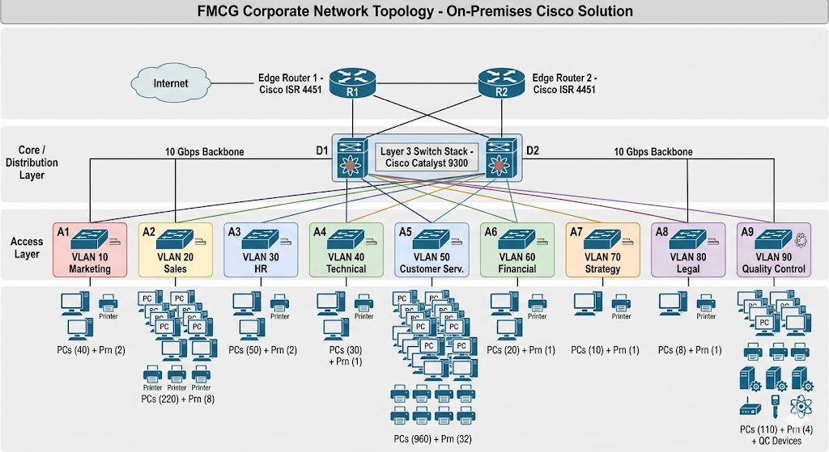
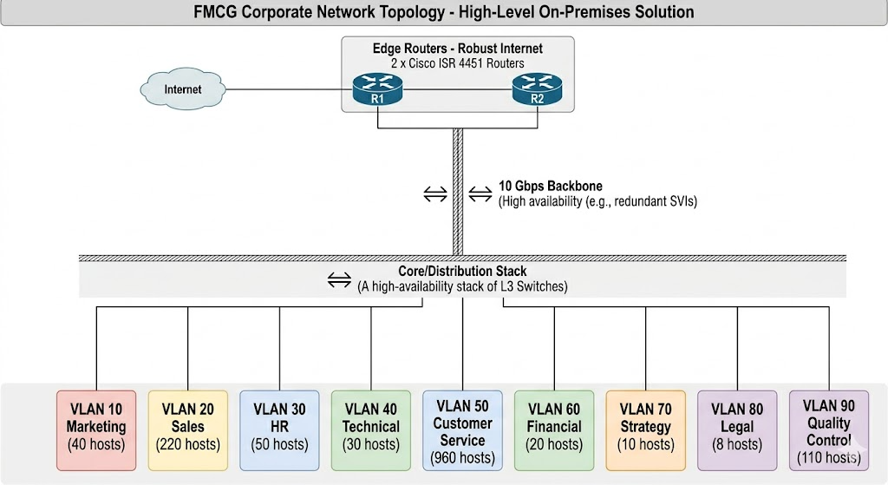
6.1 Topology
For labels, use:
Marketing — VLAN 10 — 172.16.5.192/26
Sales — VLAN 20 — 172.16.4.0/24
HR — VLAN 30 — 172.16.5.128/26
Technical — VLAN 40 — 172.16.6.0/27
Customer Service — VLAN 50 — 172.16.0.0/22
Financial — VLAN 60 — 172.16.6.32/27
Strategy — VLAN 70 — 172.16.6.64/28
Legal — VLAN 80 — 172.16.6.80/28
Quality Control — VLAN 90 — 172.16.5.0/25
This hierarchical extended star topology provides high scalability, fault isolation, and easier troubleshooting. If one access switch fails, it does not impact the entire network. It also supports future expansion by allowing additional switches to be added without major redesign.
Network Address Translation (NAT) will be implemented at the edge router to allow internal private IP addresses to communicate with external networks using public IP addresses.

Slide 10
6.2 Cabling Design
To support a 10 Gbps network, the following cabling is recommended:
Backbone connections: Fiber optic cables (OM3/OM4 multimode or single mode) for high-speed and long-distance communication.
Access layer connections: Category 6a (Cat6a) Ethernet cables, which support up to 10 Gbps over standard office distances.
This combination ensures high performance, reliability, and future scalability of the network.
7. Detailed Budget and 10-Year TCO Calculation
The earlier draft only listed total amounts. This section shows the full cost calculation process. Because exact pricing changes by supplier and date, the figures below are presented as reasonable estimate values in CAD for assignment purposes. The same formulas can be reused if you later replace the unit prices with vendor quotations.
7.1 Hardware Cost Table
7.2 Labour Cost Table
Item | Model / Description | Qty | Unit Cost (CAD) | Calculation | Line Total (CAD)
Access / Distribution Switch | Cisco Catalyst 9300 Series | 10 | 6,000 | 10 x 6,000 | 60,000
Router | Cisco ISR 4451 | 2 | 8,000 | 2 x 8,000 | 16,000
Role | Hours | Rate (CAD/hr) | Cost (CAD)
Network design, installation and testing | 80 | 60 | 4,800
Labour subtotal calculation:
Implementation Labour = 80 hours x CAD 60/hour
Implementation Labour = CAD 4,800

Slide 11
7.3 Maintenance and 10-Year TCO Table
Hardware subtotal calculation:
Hardware Cost = (10 x CAD 6,000) + (2 x CAD 8,000)
Hardware Cost = CAD 60,000 + CAD 16,000
Hardware Cost = CAD 76,000
Component | Formula | Amount (CAD)
Hardware | (10 x 6,000) + (2 x 8,000) | 76,000
Labour | 80 x 60 | 4,800
Maintenance over 10 years | (76,000 x 0.05) x 10 | 38,000
Total Cost of Ownership | 76,000 + 4,800 + 38,000 | 118,800
Maintenance calculation:
Annual Maintenance = 5% x Hardware Cost
Annual Maintenance = 0.05 x 76,000
Annual Maintenance = CAD 3,800
10-Year Maintenance = Annual Maintenance x 10
10-Year Maintenance = 3,800 x 10
10-Year Maintenance = CAD 38,000
Budget justification note:
Cisco Catalyst 9300 switches were selected due to their support for VLAN segmentation, Layer 3 capabilities, and 10 Gbps uplinks suitable for enterprise environments. Cisco ISR 4451 routers were chosen because they provide reliable WAN connectivity, advanced routing features, and support for secure network operations such as VPN and NAT.
Pricing Note:
The device prices used in this estimate are based on average market pricing for Cisco enterprise equipment (Cisco official partners, CDW, and online enterprise hardware vendors). Actual pricing may vary depending on supplier, configuration, and discounts.

Slide 12
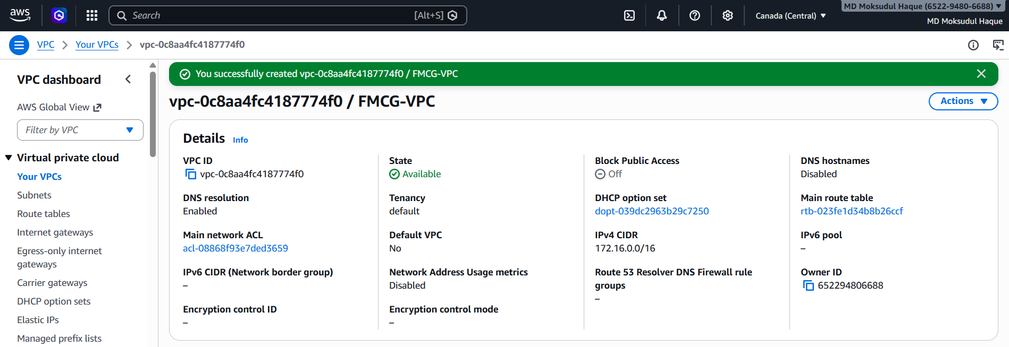
Part 02: AWS VPC CLOUD NETWORK DESIGN
Introduction
This section presents the AWS cloud-based network design for the FMCG organization. Instead of using physical infrastructure, the network is implemented using Amazon Virtual Private Cloud (VPC), which provides a scalable, secure and highly available virtual networking environment.
The design follows the same logical structure as the Cisco network, where each department is isolated using subnets. AWS services such as EC2, Internet Gateway, Route Tables and Security Groups are used to replicate enterprise-level networking in the cloud.
VPC Created

Slide 13
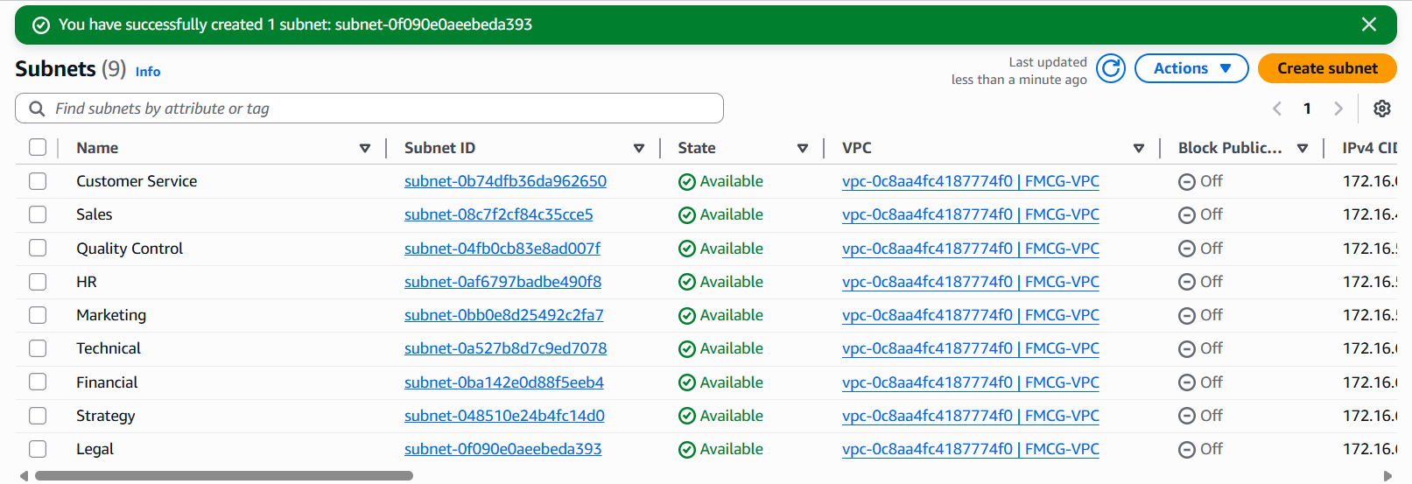
SUBNET DESIGN
Department | CIDR | Subnet Type
Customer Service | 172.16.0.0/22 | Private
Sales | 172.16.4.0/24 | Private
Quality Control | 172.16.5.0/25 | Private
HR | 172.16.5.128/26 | Private
Marketing | 172.16.5.192/26 | Public
Technical | 172.16.6.0/27 | Private
Financial | 172.16.6.32/27 | Private
Strategy | 172.16.6.64/28 | Private
Legal | 172.16.6.80/28 | Private
SUBNET Created

Slide 14
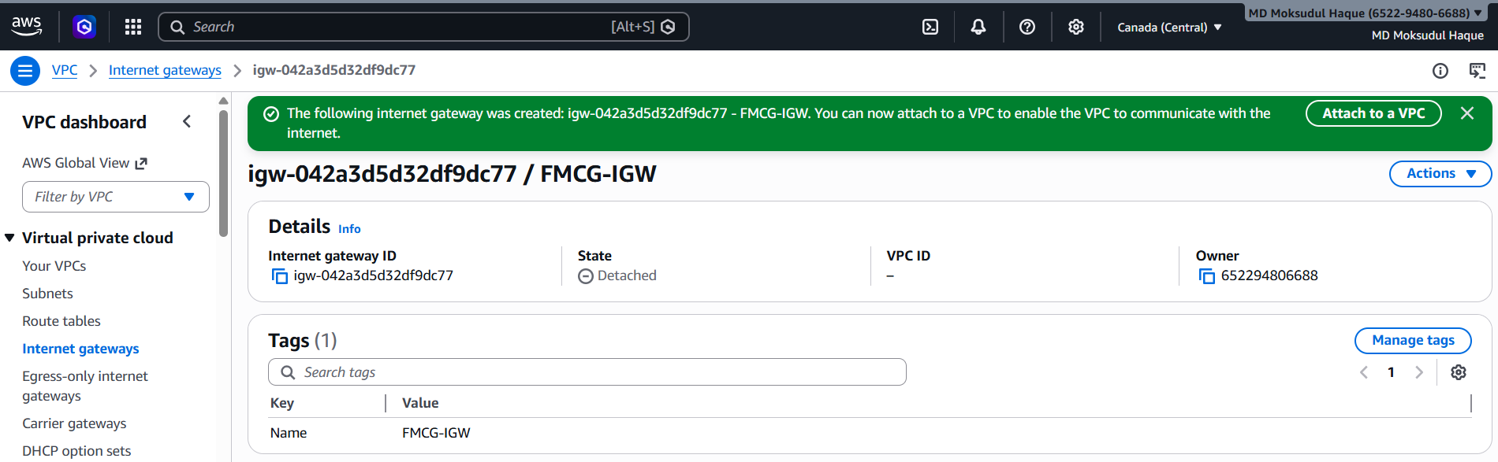
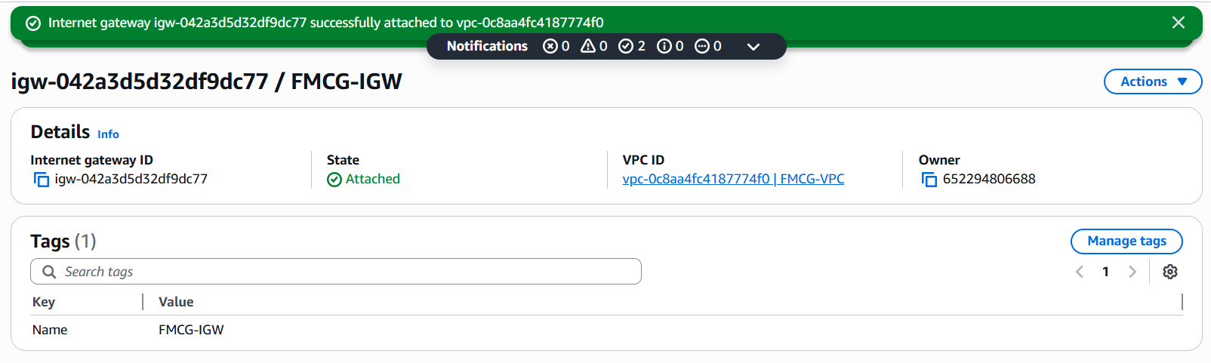
Internet Connectivity Design - Internet Gateway Created
Attach to VPC (FMCG-VPC)

Slide 15
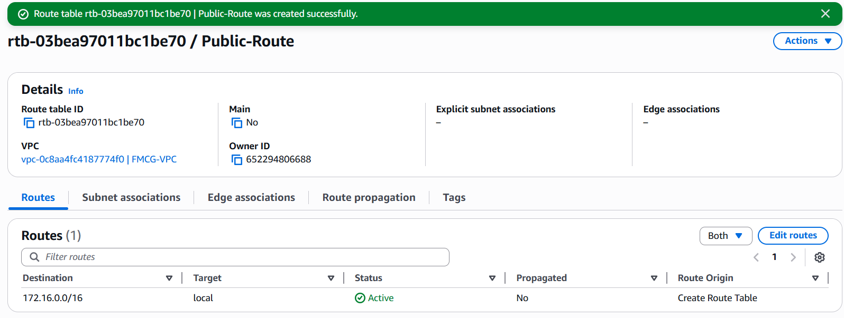
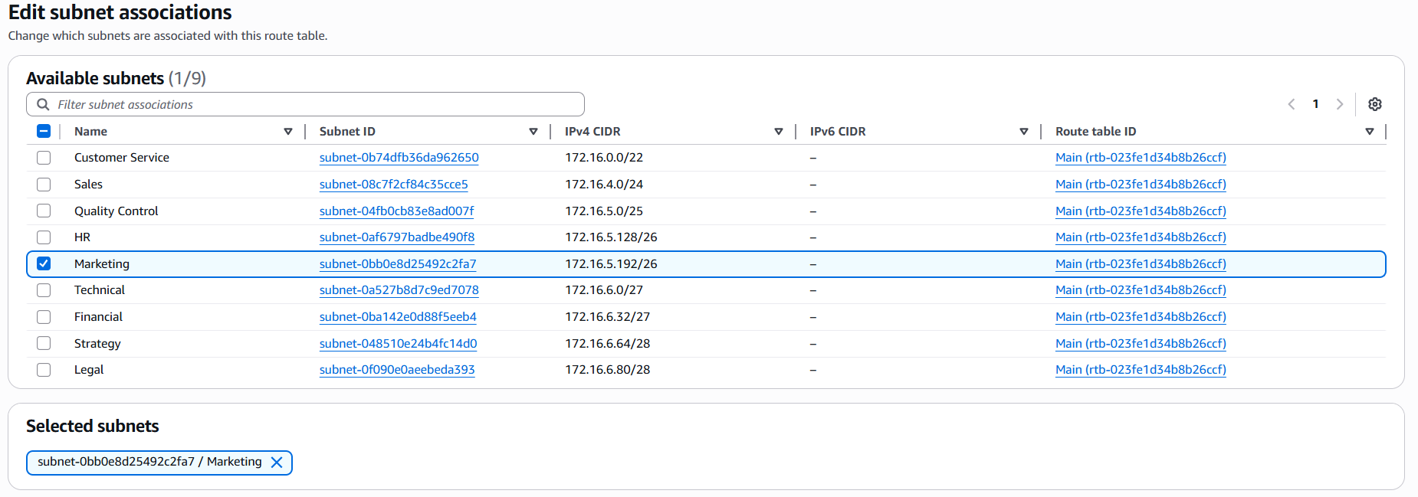
Public Route Table Created
Associating Marketing Subnet

Slide 16
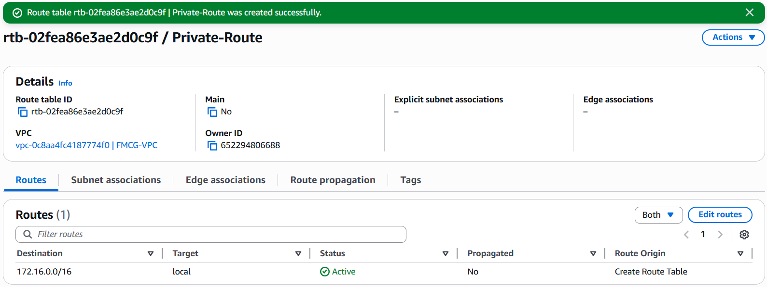
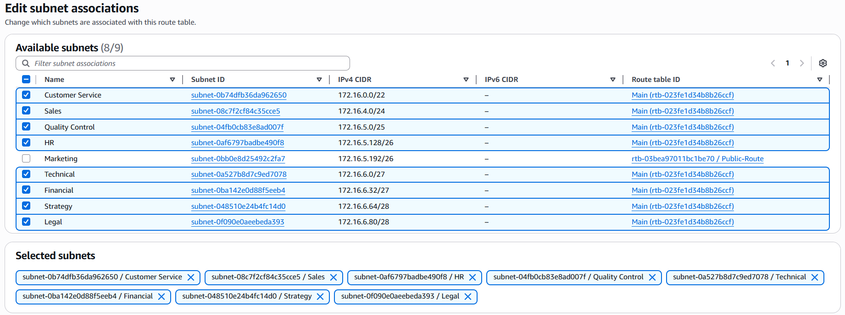
Private Route Table Created

Slide 17
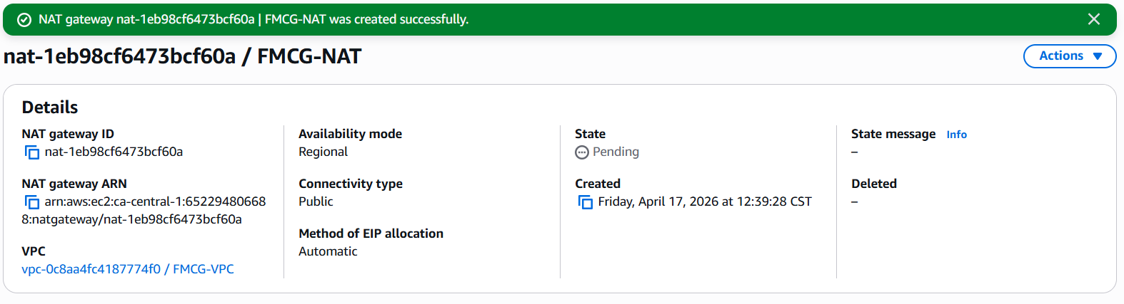
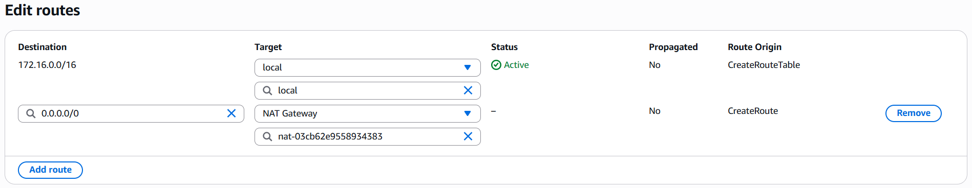
NAT Gateway Created
Route table update

Slide 18
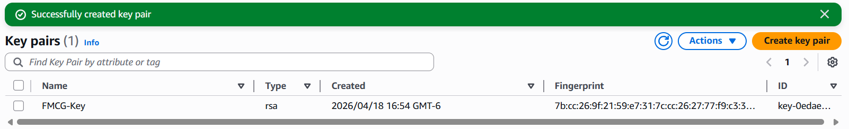
EC2 Deployment
EC2 instances are deployed within the VPC to simulate departmental systems. Each department is assigned an EC2 instance inside its respective subnet. The Marketing department is placed in a public subnet with a public IP, while all other departments are deployed in private subnets without direct internet access. These private instances access the internet through a NAT Gateway for updates and external communication.
Department | Subnet Type | EC2 Access
Marketing | Public Subnet | Public EC2 (with public IP)
Customer Service | Private Subnet | Private EC2
Sales | Private Subnet | Private EC2
Quality Control | Private Subnet | Private EC2
HR | Private Subnet | Private EC2
Technical | Private Subnet | Private EC2
Financial | Private Subnet | Private EC2
Strategy | Private Subnet | Private EC2
Legal | Private Subnet | Private EC2
Public EC2 instances are directly reachable from the internet, while private EC2 instances are protected and only accessible within the VPC or through secure methods such as a bastion host or VPN.
Key Pair Created

Slide 19
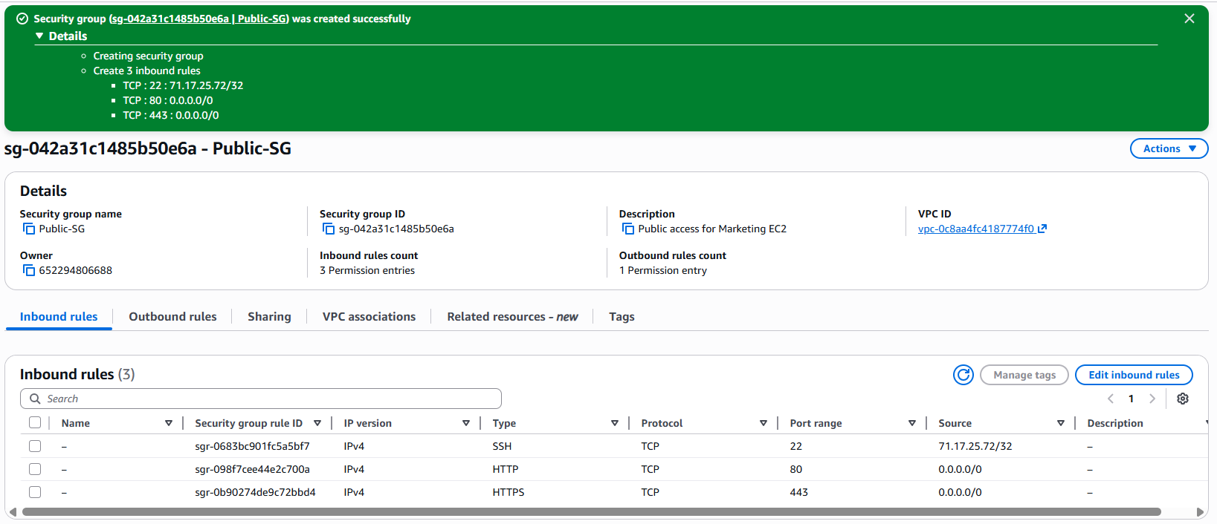
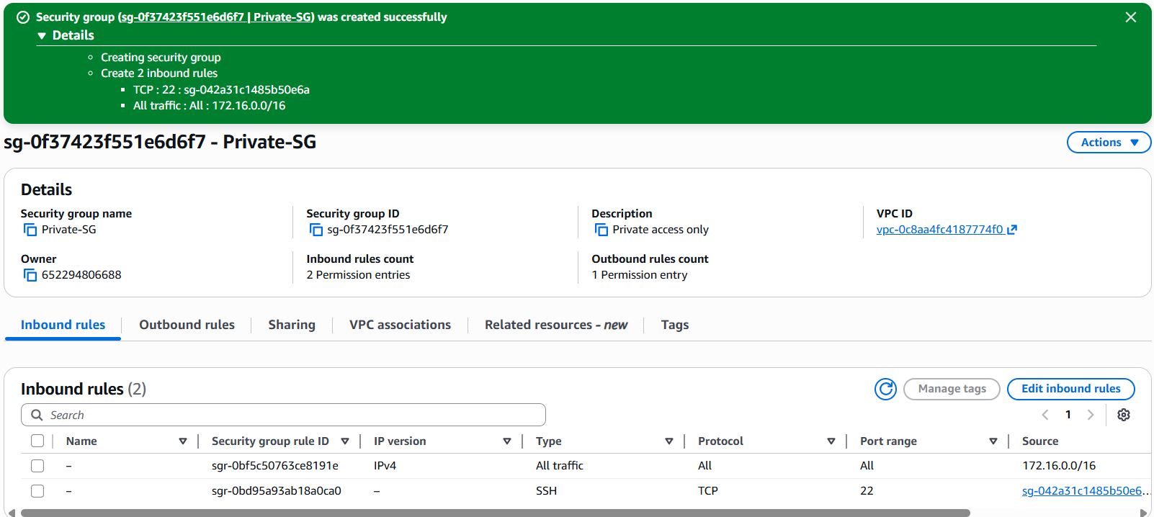
Public Security Group Created
Private Security Group Created

Slide 20
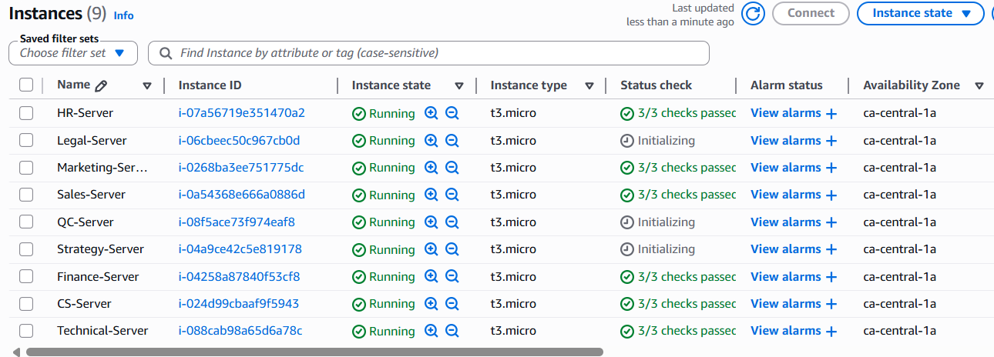
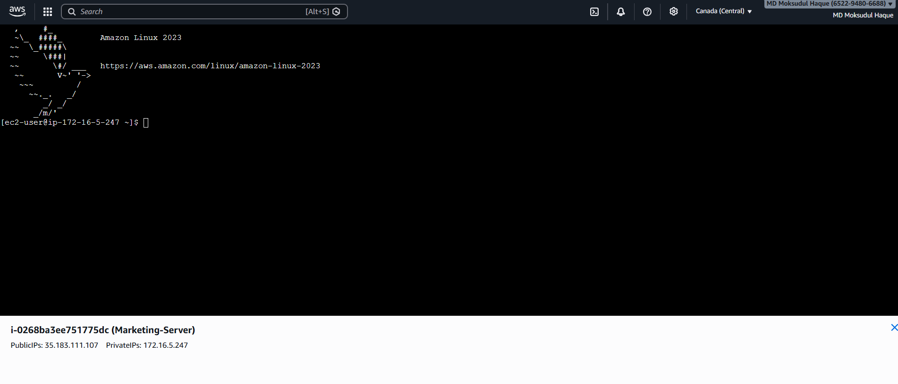
All the Instances
Connect to Public EC2 (Marketing-Server)

Slide 21
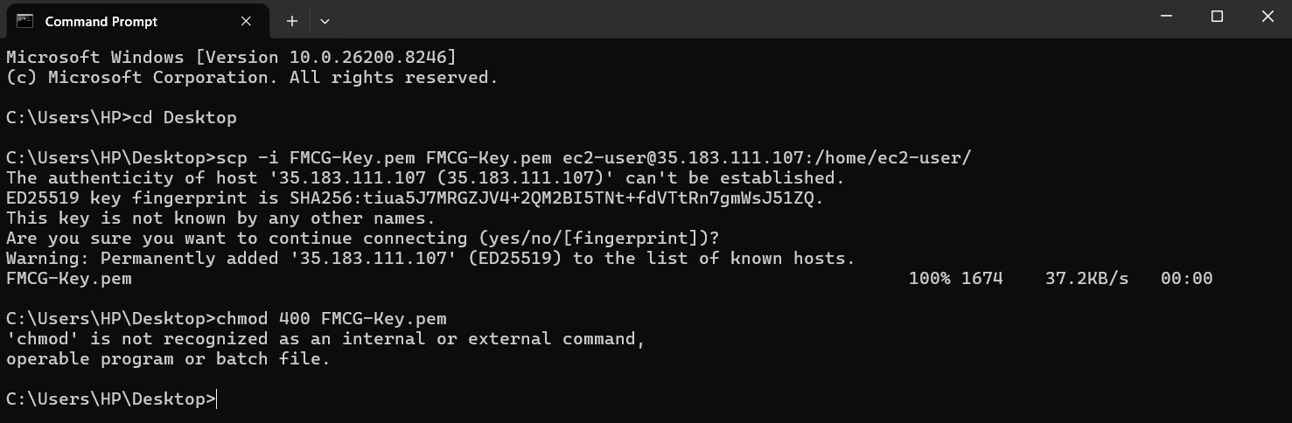
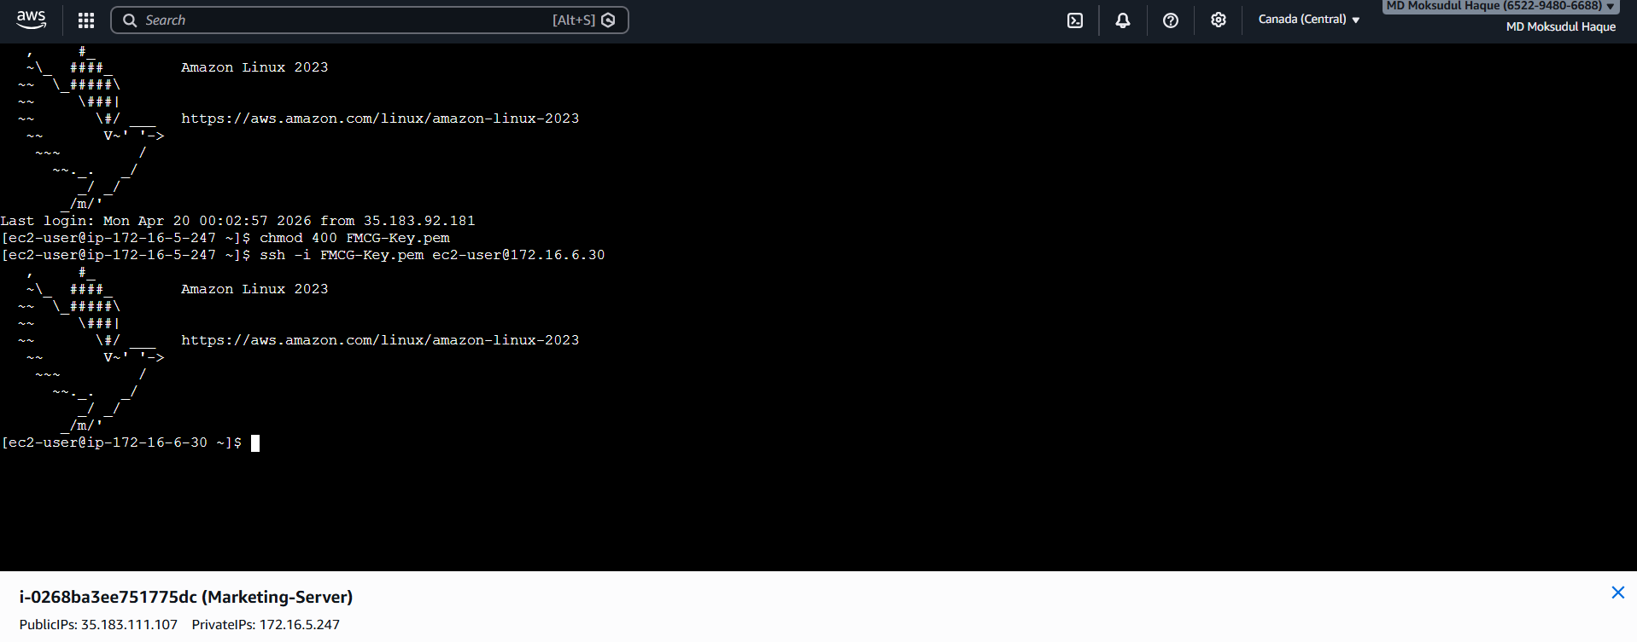
Connect to Private EC2
Run SCP command in Run > CMD
FMCG-Key.pem, located in Desktop.
Upload and Run FMCG-Key.pem from Desktop
From AWS terminal,
Private subnet internet access
Public to Private internet access is working, and
Bastion host is working perfectly.
chmod 400 FMCG-Key.pem
ssh -i FMCG-Key.pem ec2-user@172.16.6.30
Public to Private connections are working perfectly.

Slide 22
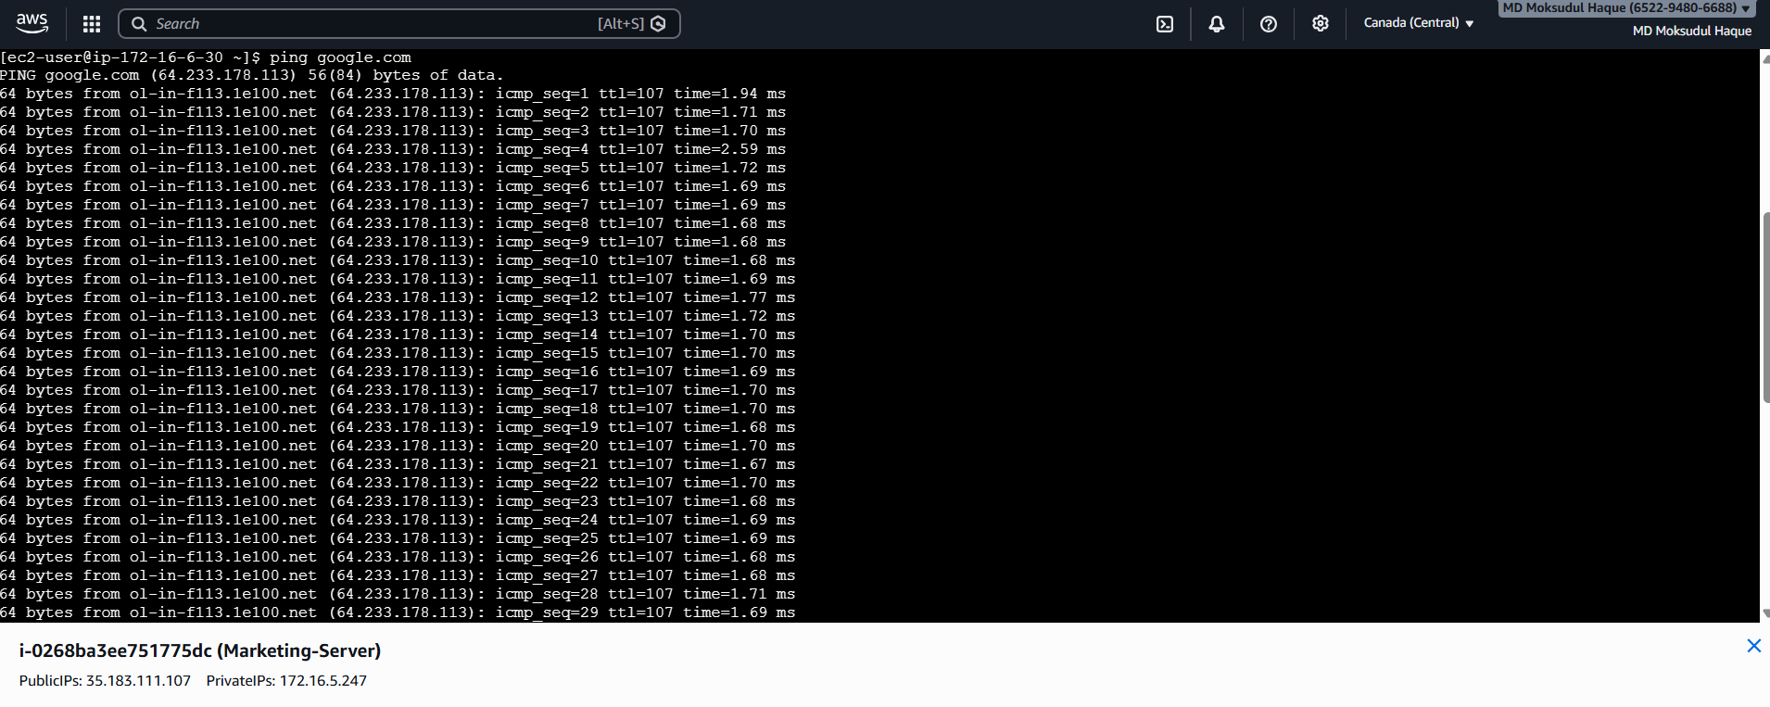
Test Internet (NAT Gateway Proof)
ping google.com

Slide 23
Bastion Host Explanation
Bastion Host Architecture in AWS
In this architecture, the Marketing EC2 instance is configured as a Bastion Host (Jump Server) to securely access private EC2 instances located in private subnets.
A Bastion Host is a specially configured EC2 instance that acts as a secure entry point for managing instances in private networks. It is placed in a public subnet and has a public IP address, allowing controlled SSH access from the internet.
How it works in our project:
The Marketing-Server EC2 (Public Subnet) has:
  Public IP enabled
  Security Group allowing SSH access only from the user’s IP
All other EC2 instances (HR, Finance, Sales, etc.) are placed in private subnets:
  No public IP assigned
  Cannot be accessed directly from the internet
Access flow:
Laptop (SSH)
→ Marketing EC2 (Bastion Host)
→ Private EC2 Instances (via private IP)

Slide 24
Security Benefits:
Private EC2 instances are completely hidden from the internet
Only one controlled entry point exists (Bastion Host)
Reduces attack surface significantly
Administrators must authenticate through the public EC2 first
Summary:
This setup ensures a secure administrative access model, where only the Bastion Host is exposed publicly, while all backend systems remain protected inside private subnets.
10-Year Cost Projection
$130 × 12 months × 10 years = $15,600 (approx.)
One-Time Manpower (Implementation Cost)
  Deployment effort: 40 hours
  Hourly rate: $60/hour
Manpower Cost:
40 Hours × $60 = $2,400
This includes:
- VPC design and setup
- Subnet configuration (public + private)
- Routing (Internet Gateway + NAT Gateway)
- EC2 deployment (all instances)
- Security Groups and Bastion Host setup
- Testing and validation
Total Estimated Monthly Cost
Component | Estimated Cost
EC2 Instances | $75
NAT Gateway | $45
Data Transfer | $10
Total | ~$130/month
Final Total AWS Project Cost (Including Manpower)
Cost Type | Amount
10-Year AWS Operational Cost | $15,600
One-Time Manpower Cost | $2,400
Total AWS Project Cost | $18,000
Comparison with Traditional Infrastructure (Cisco / On-Premises)
Solution | Estimated 10-Year Cost
Cisco On-Premises Setup | ~$118,800
AWS Cloud Architecture | ~$18,600

Slide 25
Part 03: Comparison & Recommendation
Comparison and Decision Factors
To determine which network solution is more suitable for the FMCG organization, both the on-premises Cisco network and the AWS VPC cloud-based network were carefully compared. The comparison was based on key factors relevant to the company’s size, future growth, and overall operational needs. These factors include cost, scalability, maintenance, security, flexibility, deployment speed, and reliability.
Category | Cisco On-Premises (Pros) | Cisco On-Premises (Cons) | AWS VPC (Pros) | AWS VPC (Cons)
Cost | One-time hardware investment | Very high upfront cost (~$118,800) | Low upfront cost, pay-as-you-go (~$18,000 over 10 years) | Ongoing operational costs
Scalability | Can scale by adding hardware | Scaling is slow and expensive | Highly scalable, resources can be added instantly | Costs increase with usage
Maintenance | Full control over hardware | Requires IT staff and ongoing maintenance | AWS manages infrastructure | Less direct hardware control
Deployment Speed | Stable once installed | Time-consuming setup and configuration | Rapid deployment of resources | Requires cloud knowledge
Security | Full physical control | Manual configuration required | Built-in security features (private subnets, security groups, NAT) | Depends on proper configuration
Reliability | Reliable with proper maintenance | Hardware failure risks | High availability and redundancy | Dependent on internet connectivity
Flexibility | Fixed infrastructure | Difficult to modify | Highly flexible and dynamic | Can become complex at scale
Accessibility | Works without internet internally | Limited remote accessibility setup | Accessible from anywhere via internet | Requires internet access

Slide 26
The decision factors above were selected because they directly impact the organization’s operational efficiency and long-term sustainability:
Cost – evaluates total investment over time
Scalability – ability to support future growth
Maintenance – effort required to manage the system
Security – protection of sensitive data
Flexibility – ability to adapt to changes
Reliability – system stability and uptime
Analysis:
The Cisco on-premises solution is a traditional approach where all networking equipment, such as switches and routers, is physically installed and managed by the organization. This gives full control over the infrastructure, which can be useful in certain situations. However, it comes with several disadvantages. The initial setup cost is very high, and the organization must also spend time and resources maintaining the hardware. In addition, if the company grows in the future, new equipment must be purchased and installed, which increases both cost and deployment time.
On the other hand, the AWS VPC solution provides a modern cloud-based approach. Instead of relying on physical devices, the network is created virtually using AWS services. One of the biggest advantages of AWS is scalability. The company can easily increase or decrease resources depending on demand, which is especially important for departments like Customer Service that have many users and expected growth.
Another major advantage is reduced maintenance. Since AWS manages the underlying infrastructure, the organization does not need to worry about hardware failures, repairs, or upgrades. This allows the company to focus more on its core business activities rather than managing IT infrastructure.
In terms of security, both solutions are capable of providing strong protection. Cisco relies on physical control and manual configurations, while AWS uses built-in features such as private subnets, security groups, and controlled access through NAT and bastion hosts. These features help protect sensitive data while still allowing necessary communication within the network.
Overall, AWS provides a more efficient, flexible, and cost-effective solution for this organization compared to the traditional Cisco approach.

Slide 27
Switch Allocation Justification:
The switch allocation in this design is intentionally based on the current operational requirements and device distribution of the FMCG organization. Each department is assigned a dedicated access switch to ensure proper segmentation, efficient traffic handling, and simplified management, while a centralized Layer 3 switch is used for inter-VLAN routing and aggregation of network traffic. This hierarchical approach provides a balanced architecture that supports approximately 1,500 devices without introducing unnecessary hardware or complexity. The design ensures that traffic remains localized at the access layer where possible, reducing congestion and maintaining performance across departments. Deploying a significantly larger number of switches at this stage would increase capital cost, configuration overhead, and maintenance complexity, without delivering proportional improvements in performance for the current scale of the network. Instead, the design prioritizes efficiency and clarity while maintaining a structured layout that is easy to manage and troubleshoot.
Scalability:
While the current design uses one EC2 instance per department to represent the network structure, this is a simplified implementation suitable for demonstration purposes. In a real-world FMCG environment, a single EC2 instance would not be sufficient to handle high user demand, ensure reliability, or provide fault tolerance. A more practical approach would involve deploying multiple EC2 instances behind a load balancer, along with auto-scaling groups to dynamically adjust resources based on traffic. This would improve performance, ensure high availability, and eliminate single points of failure, making the cloud solution more robust and production-ready. In terms of security, both solutions can provide strong protection. Cisco relies on physical control and manual configurations, while AWS uses built-in features such as private subnets, security groups, and controlled access through NAT and bastion hosts. These features help protect sensitive data while still allowing necessary communication within the network. Overall, AWS provides a more efficient, flexible, and cost-effective solution for this organization compared to the traditional Cisco approach.

Slide 28
Final Recommendation:
Based on the comparison and analysis, AWS VPC is recommended as the best network solution for the FMCG organization.
The most significant factor in this decision is cost. The Cisco solution has an estimated total cost of approximately $118,800 over 10 years, while the AWS solution is around $18,000. This is a major difference and makes AWS a much more affordable option for the company.
In addition to cost savings, AWS offers better scalability. The organization can easily handle growth without needing to redesign the network or purchase new hardware. This is very important for a growing company, especially with departments like Customer Service that already require many resources.
AWS also simplifies maintenance. Since the infrastructure is managed by AWS, the organization does not need to dedicate as many resources to maintaining and troubleshooting hardware. This reduces workload and operational complexity.
From a security perspective, AWS still provides strong protection. By using private subnets, controlled access, and secure connection methods, sensitive systems can remain protected while still allowing necessary communication.
Hybrid Consideration
A hybrid solution can also be considered as an alternative approach. In this case, critical departments such as Finance, HR, and Legal could remain on a Cisco on-premises network, while other departments and scalable services are hosted on AWS.
This approach can provide additional control over sensitive data and systems. However, it also introduces more complexity, as the organization would need to manage both on-premises and cloud environments. It may also increase overall cost due to maintaining two different systems and ensuring proper integration between them.
Because of these challenges, while a hybrid approach is a valid option, it may not be the most efficient solution for this organization.
Final Statement
In conclusion, AWS VPC is the most suitable solution for the FMCG organization. It offers significant cost savings, better scalability, improved flexibility, and reduced maintenance compared to the Cisco on-premises network. Although Cisco provides strong control and reliability, AWS is a more practical and future-ready solution that better meets the needs of the organization.

